Slide 1


Protecting Health Wearables
from Cyber Attack
Wearables and the Internet of Things Symposium
Indiana University Research and Technology Corporation
April 26, 2019
Florence D. Hudson
Special Advisor – NSF Cybersecurity CoE
Center for Applied Cybersecurity Research
Indiana University
Mitch Parker
Executive Director, Information Security and Compliance
Indiana University Health
Adjunct Lecturer Health Informatics - IUPUI
1

Slide 2
Mitch Parker - Background
Executive Director of Information Security and Compliance, IU Health, Sep. 2016 -
Former CISO, Temple University Health System, Nov. 2008- Sep. 2016
10+ years in securing medical devices in academic health environments
6 years DOD Information Assurance experience vetting vendors to DOD standards
2

Slide 3
What is the current device situation?
Standalone devices that connect to smartphones and PCs
A lot of devices sending info to PC/smartphone apps and the cloud
Trend to use these devices to reduce length of stay by healthcare providers
Trend to use these to capture compliance analytics, especially with CPAP machines
Consumer devices starting to be used as part of treatment and monitoring
3

Slide 4
What we have to deal with in health systems
We have to evaluate these devices for risk
Large varieties of encryption and protection on device
Large varieties on how device info makes its way to the Electronic Medical Record or for clinical decisioning
Have to evaluate each solution for how it handles identity
4

Slide 5
What we have to deal with in health systems
Question: How do we know this data is valid and belongs to the person?
We have a requirement under the HIPAA Security Rule for Confidentiality, Availability, and Integrity of data presented to an EMR for payment, treatment, or operations
We have had to architect solutions to provide additional network security and wireless security
Security solutions often 1-2 years behind state of the art
Only the higher end devices get full manufacturer support. Consumer devices have a much shorter lifecycle - a year if we are lucky
5

Slide 6
Identity Issues
Numerous different ways to authenticate users, patients, providers
While federation is prevalent in higher education, there are still a lot of islands in healthcare
The VA has non-federated identities as part of their VistA EMR
Many larger health systems don't federate their EMR systems
This leads to an inability to review access at a global level
Unique non-SSN patient identifier was part of the original Omnibus Rule, and was removed due to influence by former Rep. Ron Paul
6

Slide 7
Identity Issues
Personal information gets duplicated all over the place and it becomes best guess - Every vendor has their own system, unlike higher ed!
Best guesses for all three as vendors have to use either personal data such as SSN, reduplicate information on different web sites, or just leave out security altogether
Password reuse leading to easily guessable passwords
Password managers are another layer of complexity that only your most educated people are going to us - have to address the 99%
Personal information all over the place and unmanaged
Separate identity stores for each system
7

Slide 8
Lack of Security is Evident
# of data breaches from IOT devices
# of unprotected devices
# of manuals of devices available on Google with instructions on how to override physician defaults (CPAP machines in particular)
Ease of breaking or falsifying data on a device
Ease of breaking into cloud providers to get the data
# of health apps reselling information as a revenue stream (https://gizmodo.com/researchers-create-fake-profiles-on-24-health-apps-and-1833474535)
8

Slide 9
FDA Premarket Guidance
What does this mean for engineering?
It hints at DevSecOps, but doesn’t go there
Doesn't encompass cloud guidance and best practices for servers
We need to really address this as well – everyone is moving to the cloud
5G = first cloud-based telecom platform
Our devices will use the cloud to communicate whether we want to or not
In its initial form, didn't account for log analysis
9

Slide 10
What this adds up to
We have a best guess on identity
We have a best guess on the data itself
High variety on how it gets protected on the device
High variety on how it gets protected in the cloud or to its ultimate EMR destination
We have to evolve to a DevSecOps mindset
10

Slide 11
What can we do?
Identity - work together on federated identity systems for devices and applications that feed data to the cloud
Make it easy for the patients, who have to remember passwords - Google etc.
Federate with providers to use their identity systems whenever possible
This gets you the ability to use the latest and greatest security protection for accounts
Get out of the ID management business
Protect data on the devices using encryption tied to the federated identities
Adopt a DevSecOps mindset to continually develop and evolve secure code
Don’t resell customer data
If you want to sell it for AI/Machine Learning data sets, get affirmative consent from users!
11

Slide 12
IEEE-Standards Association Working Group: Clinical IoT Data and Device Interoperability with TIPPSS
Pre-Standards Activity Completed – Formal Standards Efforts In Development
Charter: Develop a viable framework for a standard or set of standards that would enable device and data interoperability with clinical-grade IoT with Trust, Identity, Privacy, Protection, Safety and Security, which may include interoperability with blockchain/DLT.
Pre-standards workstream participants included industry, academia, govt representatives from Ascension, Bayer, Cognizant, ERT, FDHint, IBM, IEEE, Indiana University Health, Intel, Medtronic, Oracle, Spiritus, Synopsys, University at Buffalo, US FDA, Wireless Research Center of North Carolina
12
Source: Florence D. Hudson

Slide 13
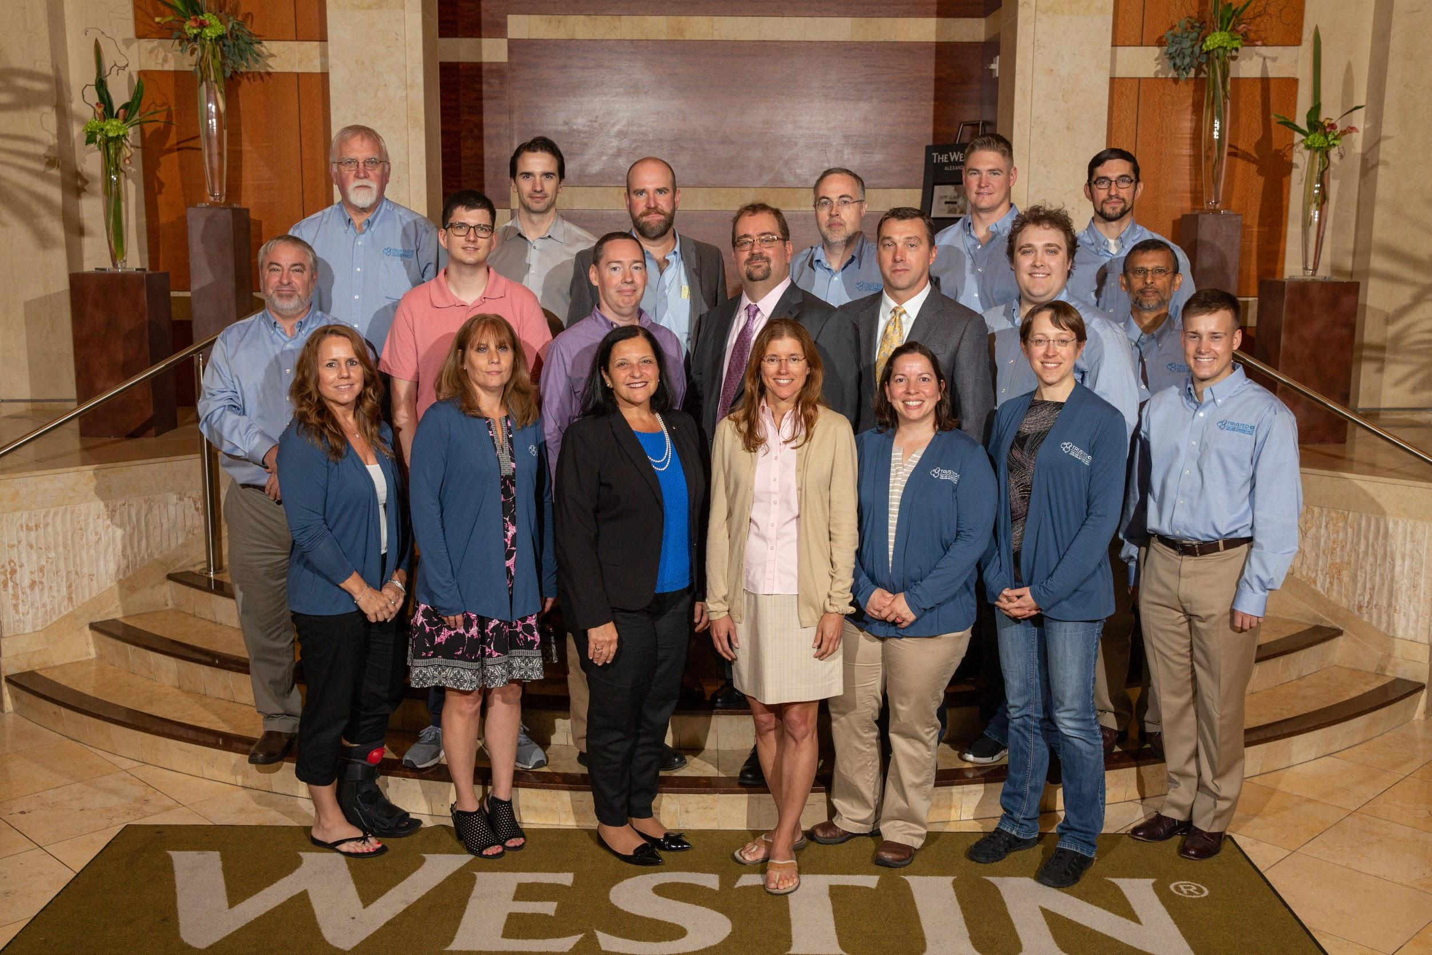




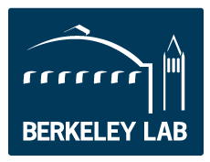

Trusted CI:
The NSF Cybersecurity Center of Excellence
Our mission: to provide the NSF community a coherent understanding of cybersecurity’s role in producing trustworthy science and the information and know-how required to achieve and maintain effective cybersecurity programs.
https://trustedci.org/
13

Slide 14
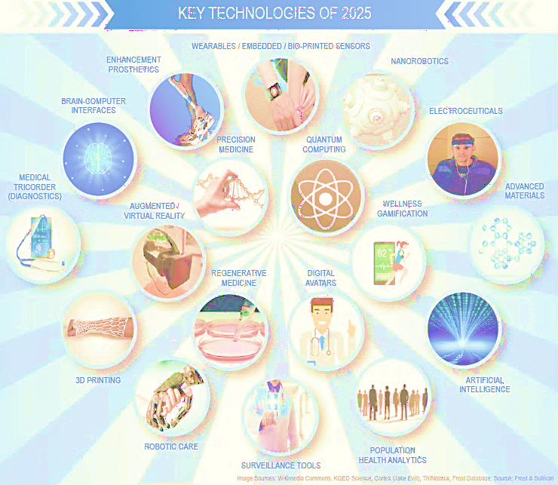
Medical IoT use and healthcare data sharing increasing
“87% of health organizations plan to adopt IoT technology by 2019.”
Healthcare IT News, Jessica Davis
“We've killed more people because we didn't share data than because we did.”
- CIO Magazine, Paddy Padmanabhan
NCI Cancer Moonshot Blue Ribbon Panel
Enhanced data sharing working group
Build a national cancer data ecosystem
Computational Approaches for Cancer annual SuperComputing workshop
14
Sources: Frost & Sullivan, CIO Magazine, Healthcare IT News, https://www.cancer.gov/research/key-initiatives/moonshot-cancer-initiative/blue-ribbon-panel, https://www.ncbi.nlm.nih.gov/pmc/articles/PMC6302370/
Notes:
Sources:
Frost & Sullivan, “Vision 2025: The Future of Healthcare Infographics.” November 2016.
SparkLabs, “Internet of Things and Hardware Industry Overview 2016.” 10 March 2016.
CIO, “Unlocking the Value in Patient-Generated Health Data.” 28 February 2017.
Healthcare IT News, “87 Percent of Health Organizations Plan to Adopt IoT Technology by 2019, Study Shows.” 28 February 2017.

Slide 15
Precision Medicine will leverage large volumes and varieties of data to improve insight & outcomes
Genomic
data
Clinical and fundamental research data
Data to Support Precision Medicine
Many data sources and types…
Wearables
Genomic data
Clinical and fundamental research
Clinical care data and observations – image, text, numerical, video, audio, etc.
Life sciences, environment data
Real World Evidence (RWE) leveraging Unique Device Identifiers (UDI)
Wearables: Connected health and patient lifestyle data
Clinical
care
data
Life sciences, environment data
Source: NIH 2015; *The New England Journal of Medicine, Vol. 378, No. 7, February 15, 2018 “Medical Devices in the Real World”
15
Notes:
Notes:
Large data volumes and analytics opportunity generated by:
Genomic data
Clinical and fundamental research data
Clinical care data and observations
Patient input including lifestyle, travel
Environmental data (weather, geography)
Wearable health and wellness devices
EMR/EHR
Images (tumors, MRIs, etc.)
Biobank data
Biotechnology, medical technology, pharma
A Biobank is a large collection of biological or medical data and tissue samples, amassed for research purposes.
Biobanks play a crucial role in biomedical research. The wide array of biospecimens (including blood, saliva, plasma, and purified DNA) maintained in biobanks can be described as libraries of the human organism. They are carefully characterized to determine the general and unique features of the continuous cell line and the absence or presence of contaminants, therefore establishing a fundamental understanding about the raw material from which the biological product is being derived and maintained. Biobanks catalog specimens using genetic and other traits, such as age, gender, blood type, and ethnicity. Some samples are also categorized according to environmental factors, such as whether the donor had been exposed to radiation, asbestos, or some other substance that can affect human genes.
Source:
National Institutes of Health, “The Precision Medicine Initiative Cohort Program - Building a Research Foundation for 21st Century Medicine.” September 2015.

Slide 16


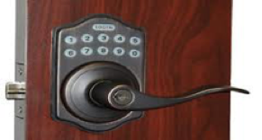


Awareness of security and privacy risk is increasing
Healthcare Device Hacking
http://bit.ly/jnjinsulinpump
http://bit.ly/medtronicinsulinpump http://bit.ly/fdarecallspacemakers
Vehicle Hacking
http://bit.ly/jeephackwired
Medical Advisory (ICSMA-19-080-01)
Xxx Radio Frequency Telemetry Protocol
Exploitable with adjacent access/low skill level to exploit.
Telemetry protocol utilized does not implement encryption. Attacker with adjacent short-range access to a target product can listen to communications, including transmission of sensitive data.
20 products utilizing this telemetry protocol are affected.
https://ics-cert.us-cert.gov/advisories/ICSMA-19-080-01
Smart Home Devices Hacking Other Devices
http://bit.ly/smartlockshack
Scientific Device Hacking
http://bit.ly/neutronstarscollide
16
Source: Florence D. Hudson
Notes:
MyCareLink Monitor, Versions 24950 and 24952,
CareLink Monitor, Version 2490C,
CareLink 2090 Programmer,
Amplia CRT-D (all models),
Claria CRT-D (all models),
Compia CRT-D (all models),
Concerto CRT-D (all models),
Concerto II CRT-D (all models),
Consulta CRT-D (all models),
Evera ICD (all models),
Maximo II CRT-D and ICD (all models),
Mirro ICD (all models),
Nayamed ND ICD (all models),
Primo ICD (all models),
Protecta ICD and CRT-D (all models),
Secura ICD (all models),
Virtuoso ICD (all models),
Virtuoso II ICD (all models),
Visia AF ICD (all models), and
Viva CRT-D (all models).

Slide 17
What could possibly go wrong? We need to protect the humans.
Top concerns:
Connected healthcare devices
Connected vehicles
Protection needed regarding:
Device, hardware, software, service hacks - physical health and safety risk
Financial risk, reputational harm
Data theft, data integrity, loss of privacy
Defense in depth needed – Hardware, firmware, software, service
Need to evolve policy and culture.
17
Sources: KPMG - Security and the IOT Ecosystem, 2015
Notes:
Sources:
IHS Technology, “IoT Platforms: Enabling the Internet of Things.” March 2016.
McKinsey, “The IoT Opportunity – Are You Ready to Capture a Once-in-a-Lifetime Value Pool?” 21 June 2016.

Slide 18
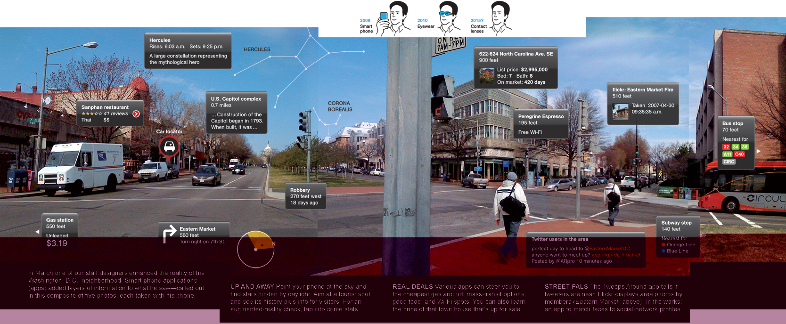
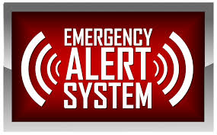
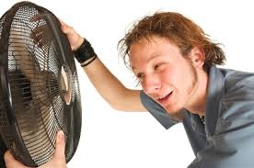
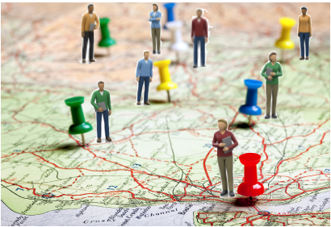
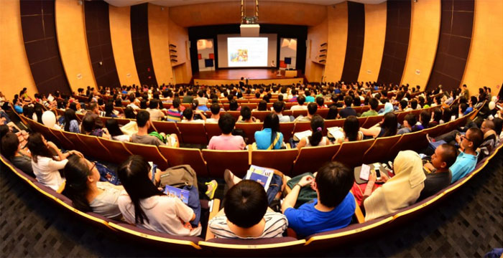
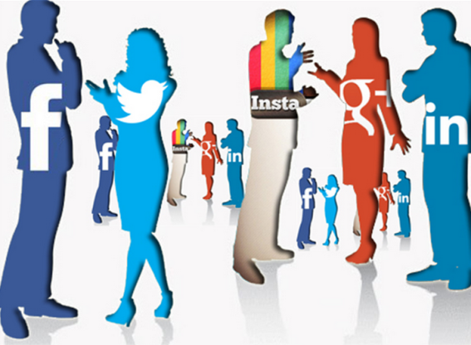

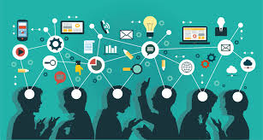
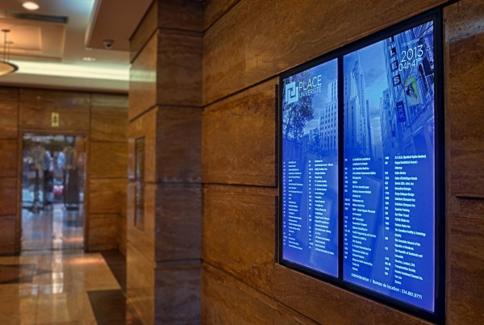


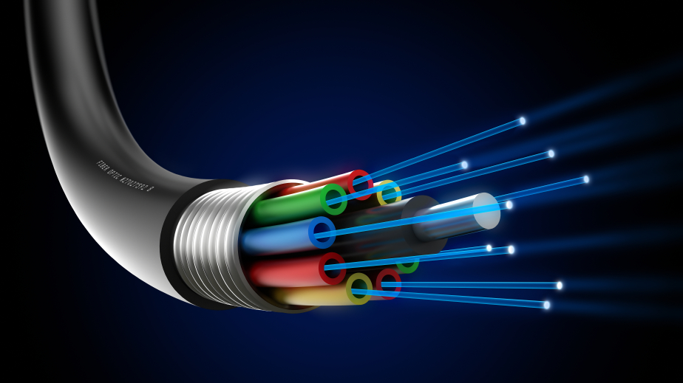


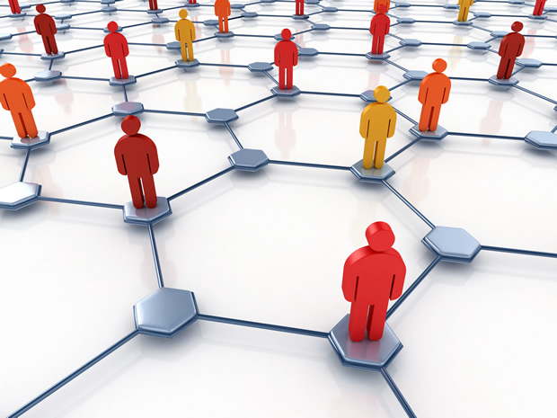
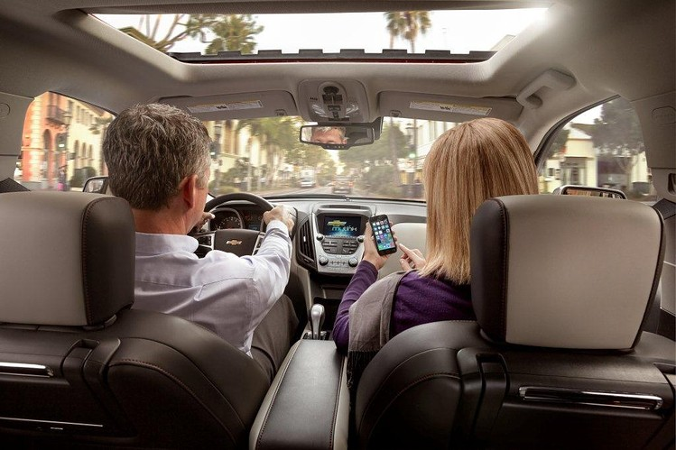
Trust, Identity, Privacy, Protection, Safety, Security for Healthcare devices and data is needed - TIPPSS
Trust: Allow only designated people/services to have device or data access
Identity: Validate the identity of people, services, and “things”
Privacy: Ensure device, personal, sensitive data kept private
Protection: Protect devices and users from harm – physical, financial, reputational
Safety: Provide safety for devices, infrastructure and people
Security: Maintain security of data, devices, people, etc.
18
Source: Florence D. Hudson
Augmented Reality
Augmented Reality
Emergency
Notifications
Emergency
Notifications
Buildings & Facilities
Buildings & Facilities
Lecture Space
Lecture Space
Social
Interaction
Social
Interaction
Environmental
Senses
Environmental
Senses
Location
Location
Location
Support
Location
Support
Network Platforms
Network Platforms
Water Systems
Water Systems
Real-Time
Collaboration
Real-Time
Collaboration
Content
Delivery
Content
Delivery
HVAC Sensors
& Controls
HVAC Sensors
& Controls
User Senses
Media
Consumption
User Senses
Media
Consumption
Data
Center
Data
Center
Inter-Server Copper & Fiber
Inter-Server Copper & Fiber
Authentication
Authentication
Mobile Device
Mobile Device
Connectivity
Network Security
Connectivity
Network Security
Vehicles
Vehicles
Notes:
Across elements of a connected ecosystem:
Users
Devices
Gateways
Communications
Clouds
Software
Services
Data
Hardware
Firmware

Slide 19
Focus on Enabling TIPPSS for IoT devices and data
19
Source: ”Enabling Trust and Security: TIPPSS for IoT”, IEEE IT Professional 2018; “Wearables and Medical Interoperability: The Evolving Frontier”, IEEE Computer 2018

Slide 20
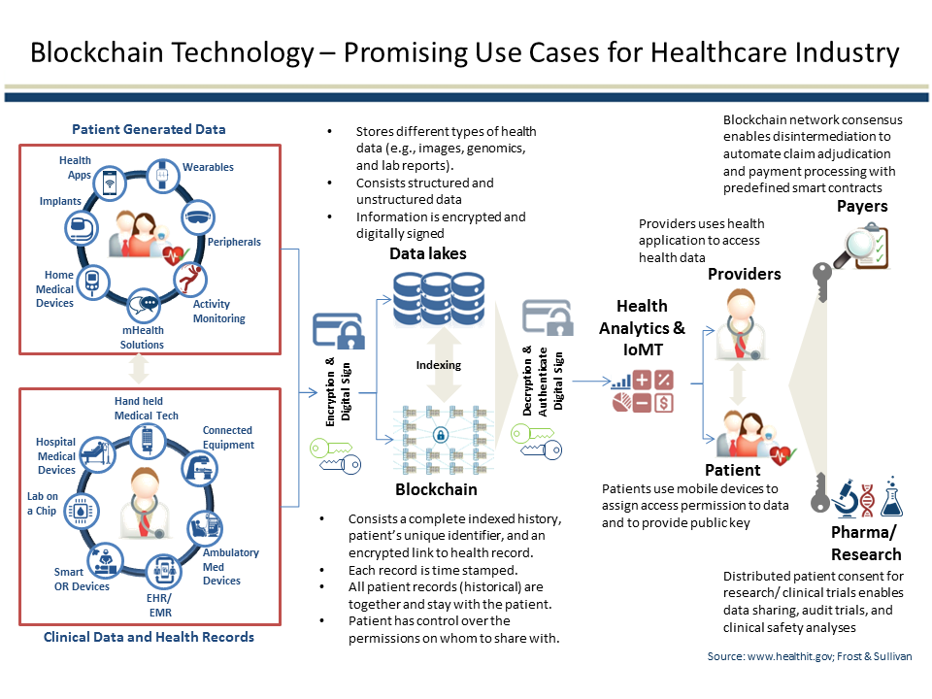
Blockchain in healthcare use cases abound
20

Slide 21
Advanced Technology Integration Will Portend the Future
Source: https://www.goodfirms.co/blog/iot-connection-with-trending-technologies
21

Slide 22
Blockchain in Healthcare Today – Open access peer-review journal
On-line journal
Original manuscripts, use cases, research
Published on a continuous basis
20,000 downloads in 65 countries
Available on Alexa!
https://blockchainhealthcaretoday.com/
22

Slide 23
Read our new book on TIPPSS for IoT by 17 women authors from around the world
23

Slide 24
Cybersecurity Research Transition to Practice (TTP)
2019 Workshop, June 19, Chicago – sponsored by TrustedCI, IURTC, Microsoft
Cybersecurity Topical Panels with Researchers and Practitioners
Artificial Intelligence / Machine Learning for Cybersecurity
Internet of Things / Cyber Physical Systems Cybersecurity
Human Factors in Cybersecurity
Cybersecurity Risk Mitigation - Data, Cloud, Cyberinfrastructure
Cybersecurity TTP Success Stories
Poster Session
“Co-creation” by practitioners and researchers for Transition to Practice
Request an invitation: https://trustedci.org/2019-ttp-workshop
24
Notes:
Image of paper ‘Crossing the "Valley of Death": Transitioning Cybersecurity Research into Practice’: https://dl.acm.org/citation.cfm?id=2498497

Slide 25
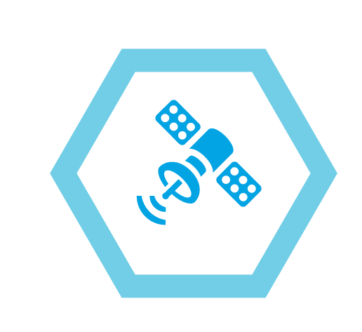
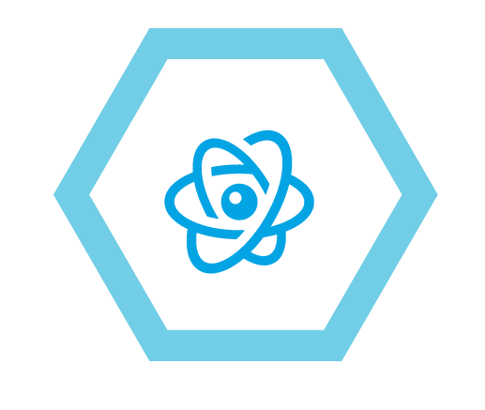
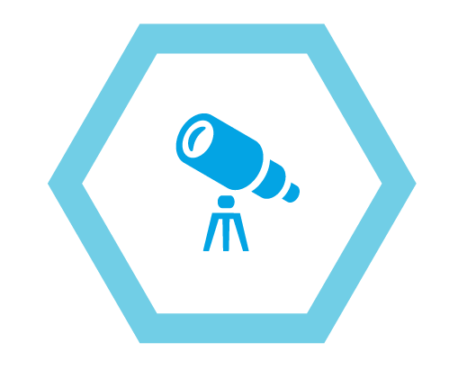
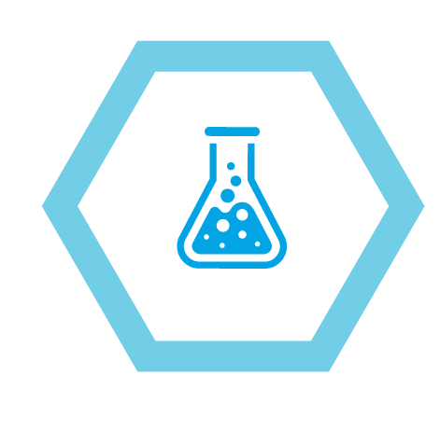
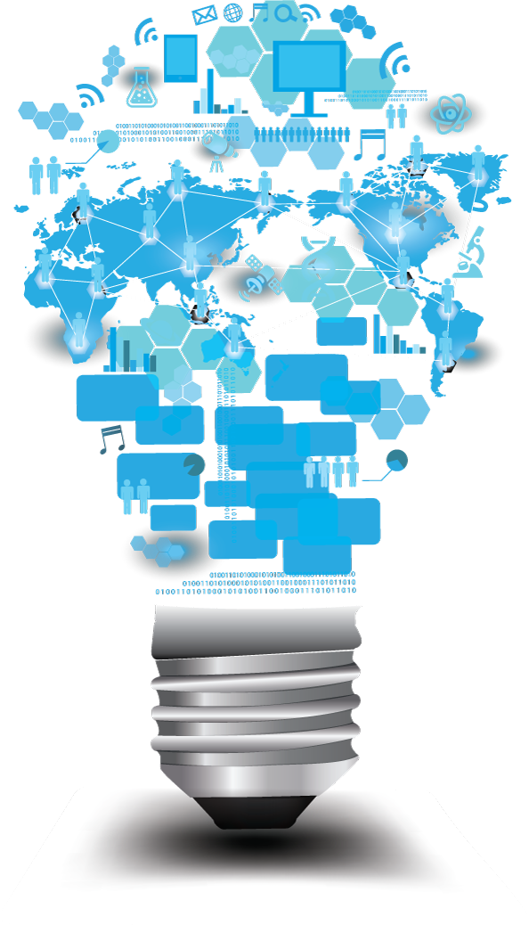

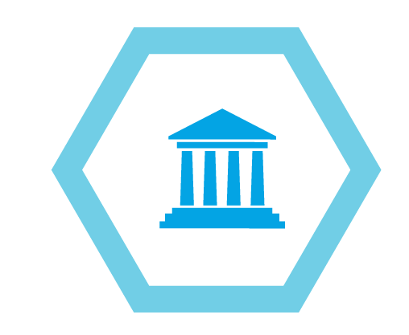
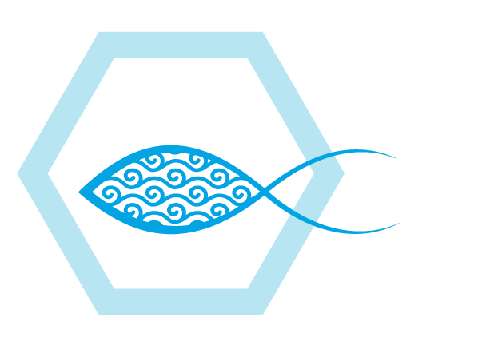

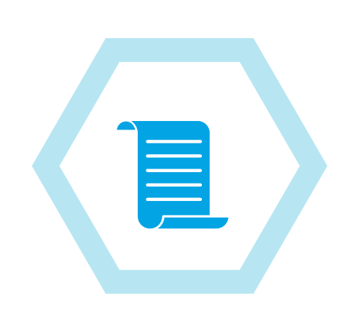

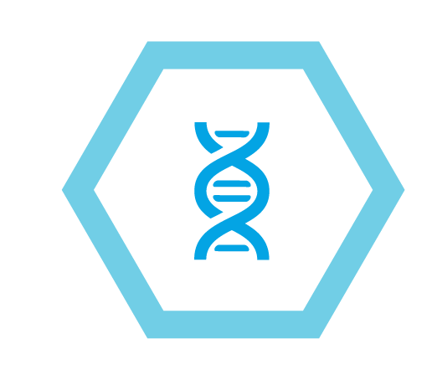
Thank You
flohudso@iu.edu
Twitter @Flo4Princeton
@FDHint
mitchell.parker@iuhealth.org
25

